Slide 1
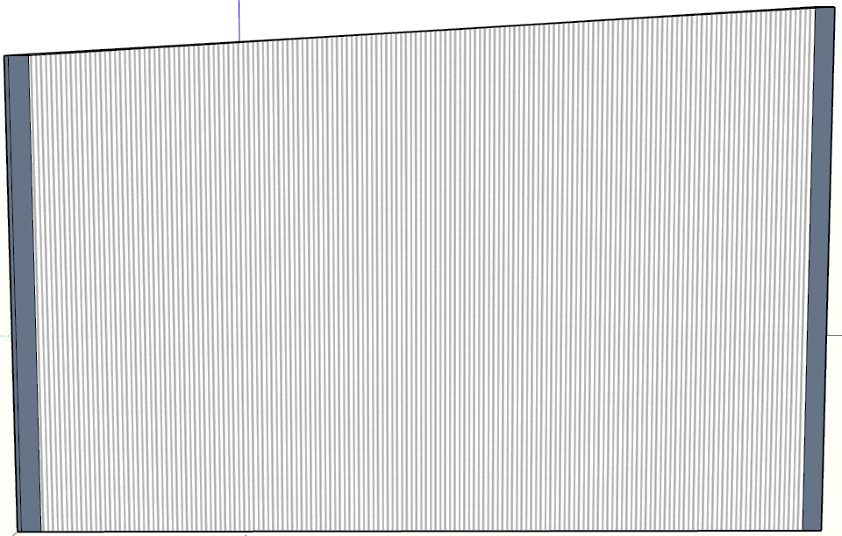
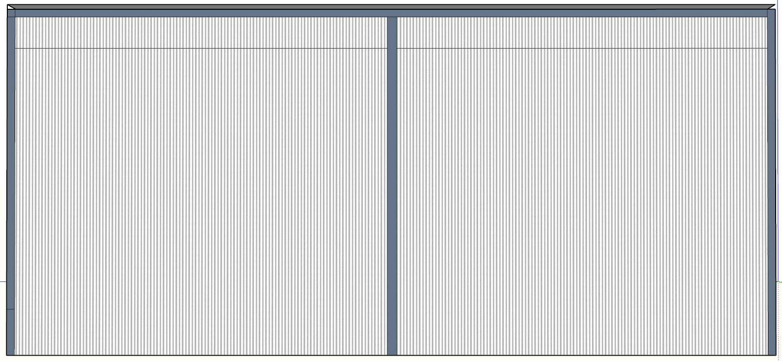
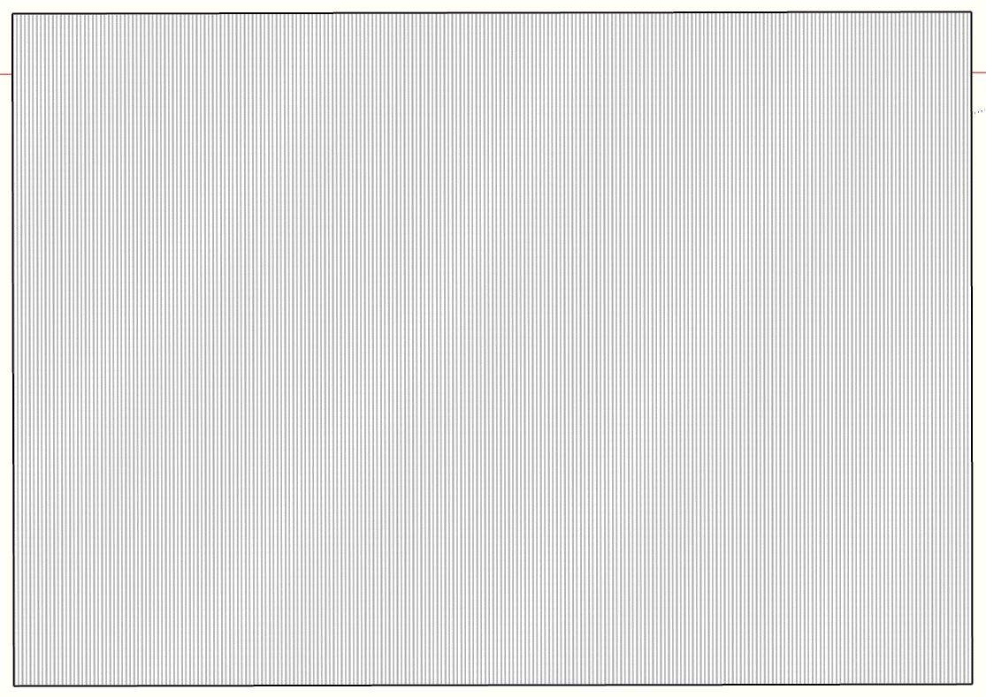
8.6m
12.3m
5.5m
4.9m
Side elevation looking North
Opening/access via front elevation looking East
Side elevation looking South
Cladding from galvanised corrugated steel to all but front elevation which is open.
Dimensions over steel.
0
Scale 1:500
5m
Rear elevation looking West
Plan View
PROPOSED STEEL STRUCTURE STORE BARN. BURGESS LANE, PENLEY, WREXHAM. LL13 0ND. 29th Oct. 2024 Rev 04

