Slide 1


PHOSPHOROUS BUDGET CALCULATIONS
FI REAL ESTATE MANAGEMENT LTD
DEVELOPMENTS AT WREXHAM IND ESTATE

Slide 2

PHOSPHOROUS BUDGET CALCULATIONS
CONTENTS
PHOSPHATES, HRA AND GUIDANCE
PHOSPHATES BUDGET CALCULATION
OPTIONS FOR MITIGATION
EXAMPLE – SITE 5 WIE
PRESENTED IN PARTNERSHIP WITH
LOGOS – DELTA SIMMONDS, BARNSLEY MARSHALL, UES, PGLA & PLAN RED

Slide 3
PHOSPHATES – HRA & GUIDANCE
Project and Policy Understanding
The proposed developments are a number of employment developments across Wrexham Industrial Estate
NRW have advised Wrexham Borough Council (WBC) in light of the unfavourable condition of the River Dee, which is a designated Special Area of Conservation (SAC), before determining a planning application that may give rise to additional phosphates within the catchment, competent authorities should undertake a Habitats Regulations Assessment (HRA).
The aim is to reduce the phosphorous input to the Wrexham Levels from new developments, this is due to growing concerns over eutrophication within these sensitive and scientifically important environments.
Following a request by WBC FIREM completed HRA Screening Assessments for its developments at Site 5 and Bridgeway Centre
  The following European sites and international designated sites were found within 10 km of the Site:
  • River Dee and Bala Lake Special Area of Conservation (SAC) at a distance of 2.93 km from the Site;
  • Johnstown Newt Sites SAC 6.0 km from the Site;
  • Berwyn and South Clwyd Mountains SAC, 9.7 km from the Site; and
  • Midland Meres & Mosses Phase 2 Ramsar, 4.63 km from the Site.
  No impact pathways were scoped in for further assessment for potential to cause a Likely Significant Effect either alone or in combination with other developments.
  The HRA Screening report found that without mitigation, there is unlikely to be a significant effect on the qualifying features of the designated sites during either the construction or operational phases of works since all potential impact pathways have been scoped out.
Whilst the NRW Guidance and the results of the HRA screening does mean employment development can be screened out for increasing Phosphates FIREM has taken the decision to target its developments as being phosphates neutral through natural based solutions

Slide 4
PHOSPHATES BUDGET CALCULATION
PEOPLE IMPACT
Model Logic have been instructed to complete a review of employment inflows into Wrexham Industrial Estate from both inside and outside the River Dee and Bala Lake SAC Catchment Area
A map of the River Dee and Bala Lake SAC was used to identify the postcode sectors that are captured within its boundary
For each of the postcode sectors, within 80km, estimates of the 2021 population were used in conjunction with the calculated travel time from Wrexham Industrial Estate
The latest 2022 ONS travel to work profile was used to apply the percentage of workers travelling within defined distance bands
Using the travel to work profile, together with the detailed mapping, the analysis calculated the percentage of workers at the Wrexham Industrial Estate who would live within the SAC boundary, this equates to 91.60 %
Therefore to calculate the net impact of the development we have assumed 8.40% of employees reside outside of the SAC boundary
SURFACE WATER IMPACT
As Wrexham phosphates calculator is not yet complete the North-Norfolks’s calculator has been use to calculate the additional phosphate loads generated from the development by people and the development itself
Methodology used is set out in Natural England’s ‘Nutrient Budget Calculator Guidance Document’.
Stage 1
Net migration in to the catchment area is expected by WBC
The net inflow has been calculated by Model Logic as explained earlier
Stage 2
Calculate existing Total Phosphates from current land use
Stage 3
Calculate the Total Phosphates loads for the proposed land uses – includes loads from new urban development and from new open spaces
Stage 4
Calculate Annual Phosphorus Budget for the proposed development. This is the total annual phosphorus load, which is necessary to mitigate for, as per the requirements

Slide 5
OPTIONS FOR MITIGATION
Use of natural based solutions on site such as Swales, Rainwater Gardens, Reed Beds
Use of natural based solutions on other FIREM owned sites within Wrexham Industrial Estate
Partnering with organisations such as Welsh Water, NRW, Wildlife Trusts Wales and WWT to develop NBS so also provide a social benefit
On site package treatment plant for generated effluent
Offsite treatment such as anaerobic digestion
Sec 106 contributions to the upgrades of the local waste water treatment works

Slide 6
EXAMPLE – SITE 5 WREXHAM IE
Generating an additional 0.63 kg/annum from the development in use (foul flows). This is based on occupancy and population location data for the catchment area and the efficacy of the serving WwTW’s (c.<1.0mg/l)
Significantly reducing the impact of Land Use development through the use of on-site SuDS features as follows:
a. Land Use Generation before SuDS mitigation = 2.89 kg/annum
b. Land Use Generation after SuDS mitigation = 0.81 kg/annum
c. Percentage reduction = 72%
SuDS features proposed include: a swale, two ponds, permeable paving and a filter drain, all as detailed on BML drawing S5A-BML-XX-XX-SK-C-006-PO1.
total phosphate increase of 1.44 kg/annum from the development
reduce this to 1.26 kg/annum (see below with extra run of filter drain prior to final discharge)

Slide 7
EXAMPLE – SITE 5 WREXHAM IE
Options for further improvement include:
a. Introduce an additional filter drain after Pond 2 which will reduce Land Use generation down to 0.63 kg/annum (drawing to be updated).
b. Split the swale so that we double the efficacy.
c. Split the filter drain so again we double the efficacy.
d. Introduce Rainwater gardens adjacent to the main road
e. Introduce an on-site foul treatment plant which will reduce phosphate into the sewer network – We need to agree how we might present this in terms of reduction in kg/annum.
f. Offer to offset against off-site creation of Wetland or re-wilding of brownfield land
g. Provide a closed foul system and management plan to take waste to your AI plant.

Slide 8
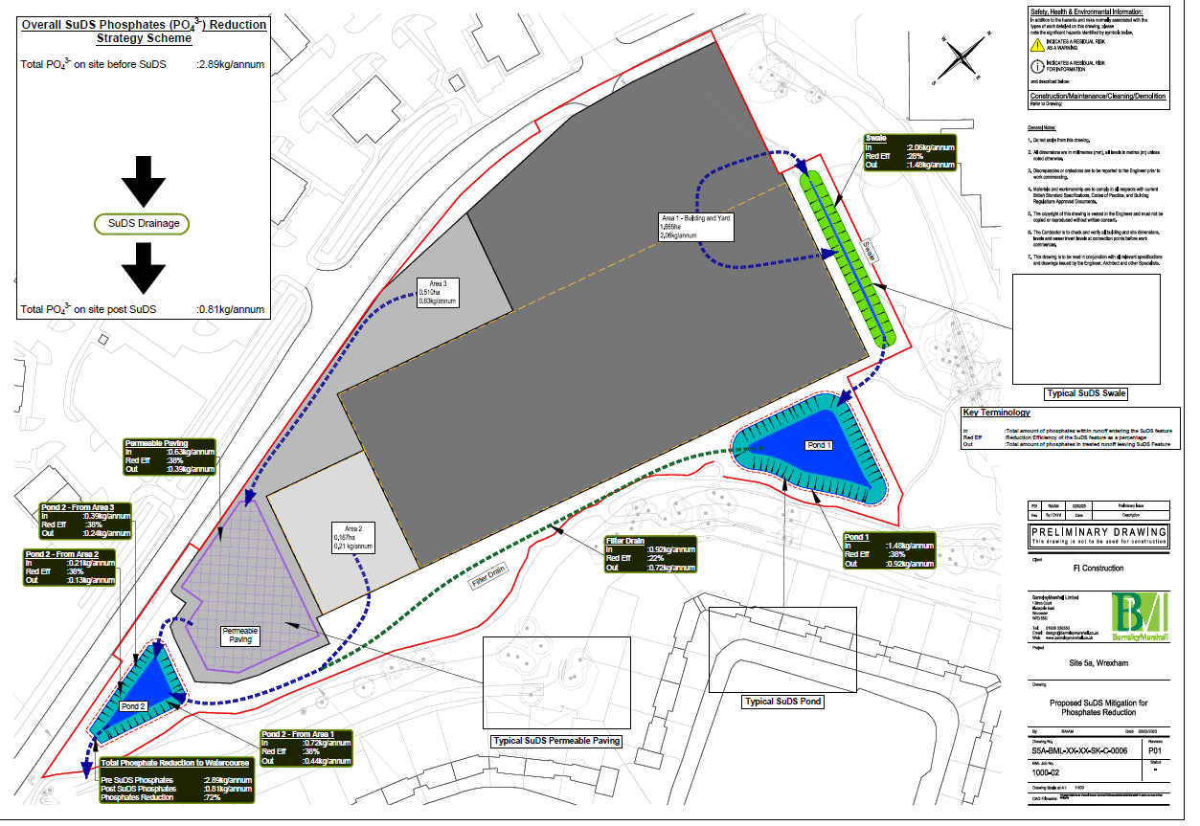
EXAMPLE – SITE 5 WREXHAM IE

Slide 9



Canal Mill, Botany Brow, Chorley, Lancashire, PR6 9AF
01257 263010 enquiries@fi-rem.com www.fi-rem.com

