Slide 1
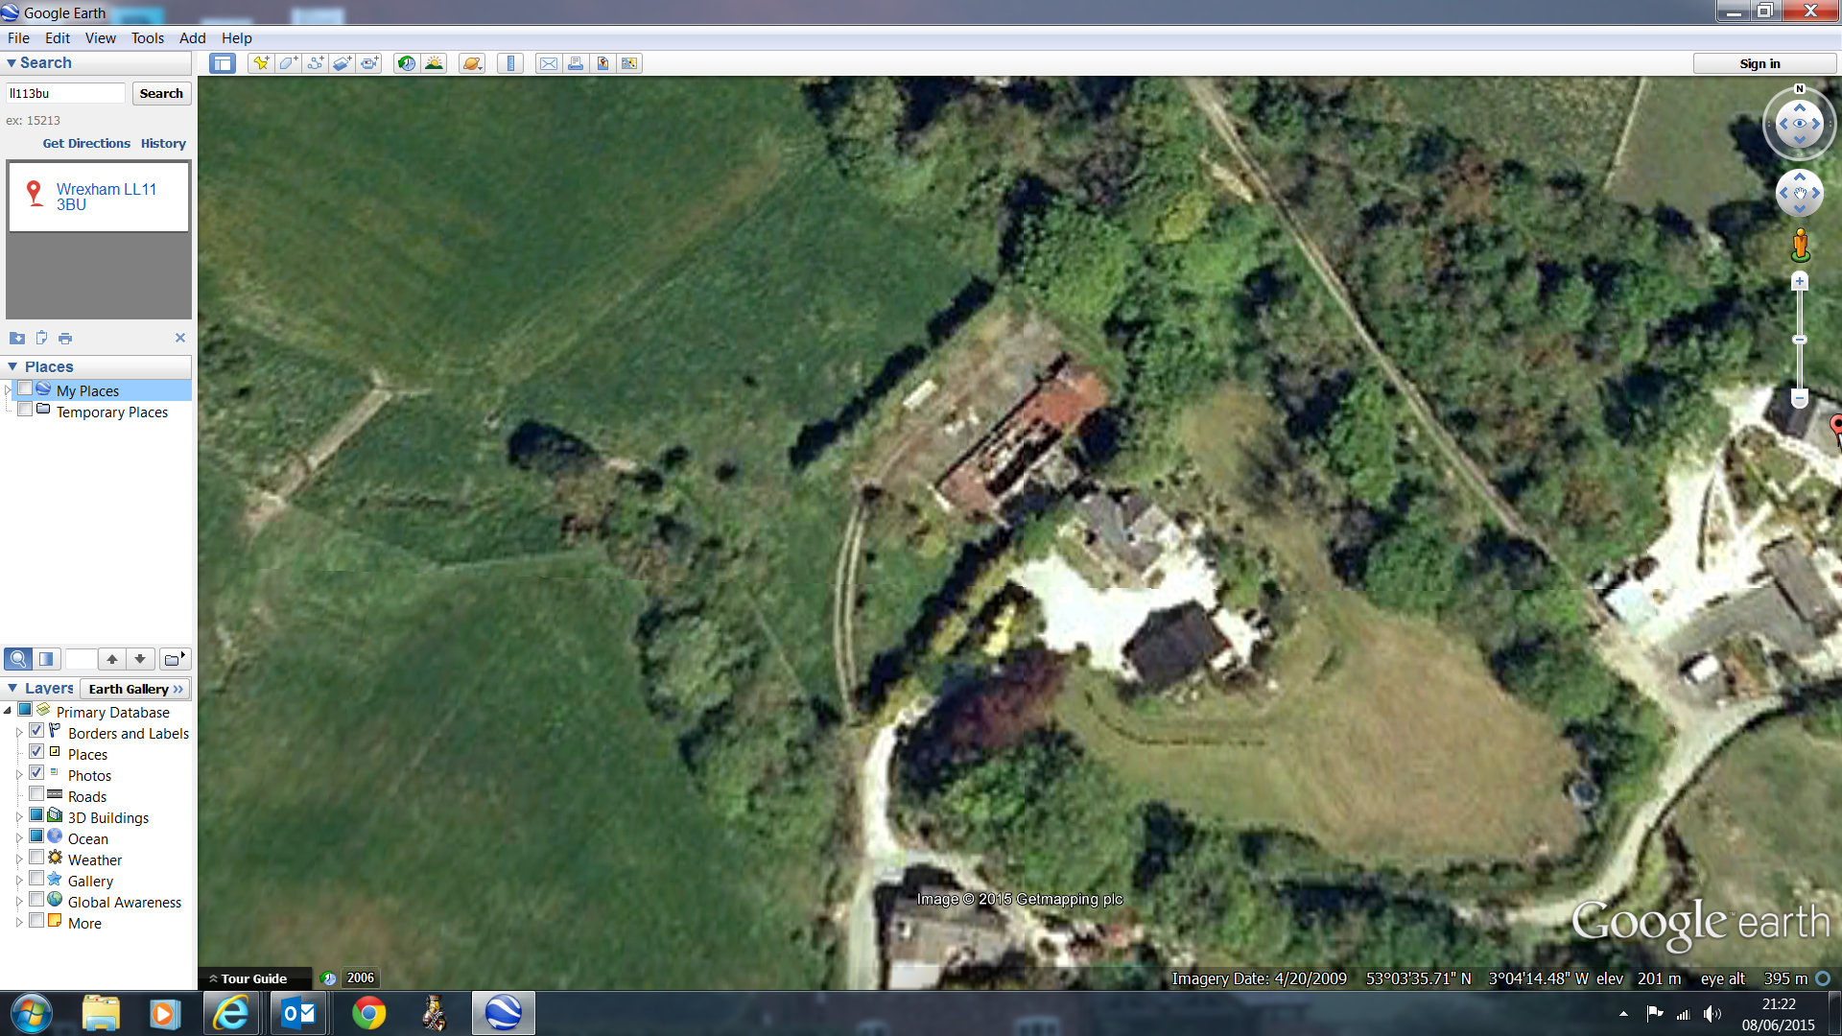
A
X
E
Hedge Line
X
Grass bund seeded with wild flowers
Manége
B
Z
Stable
Hedge Line
Beech Hedge
X
D
Hedge Line
X
C

