Slide 1

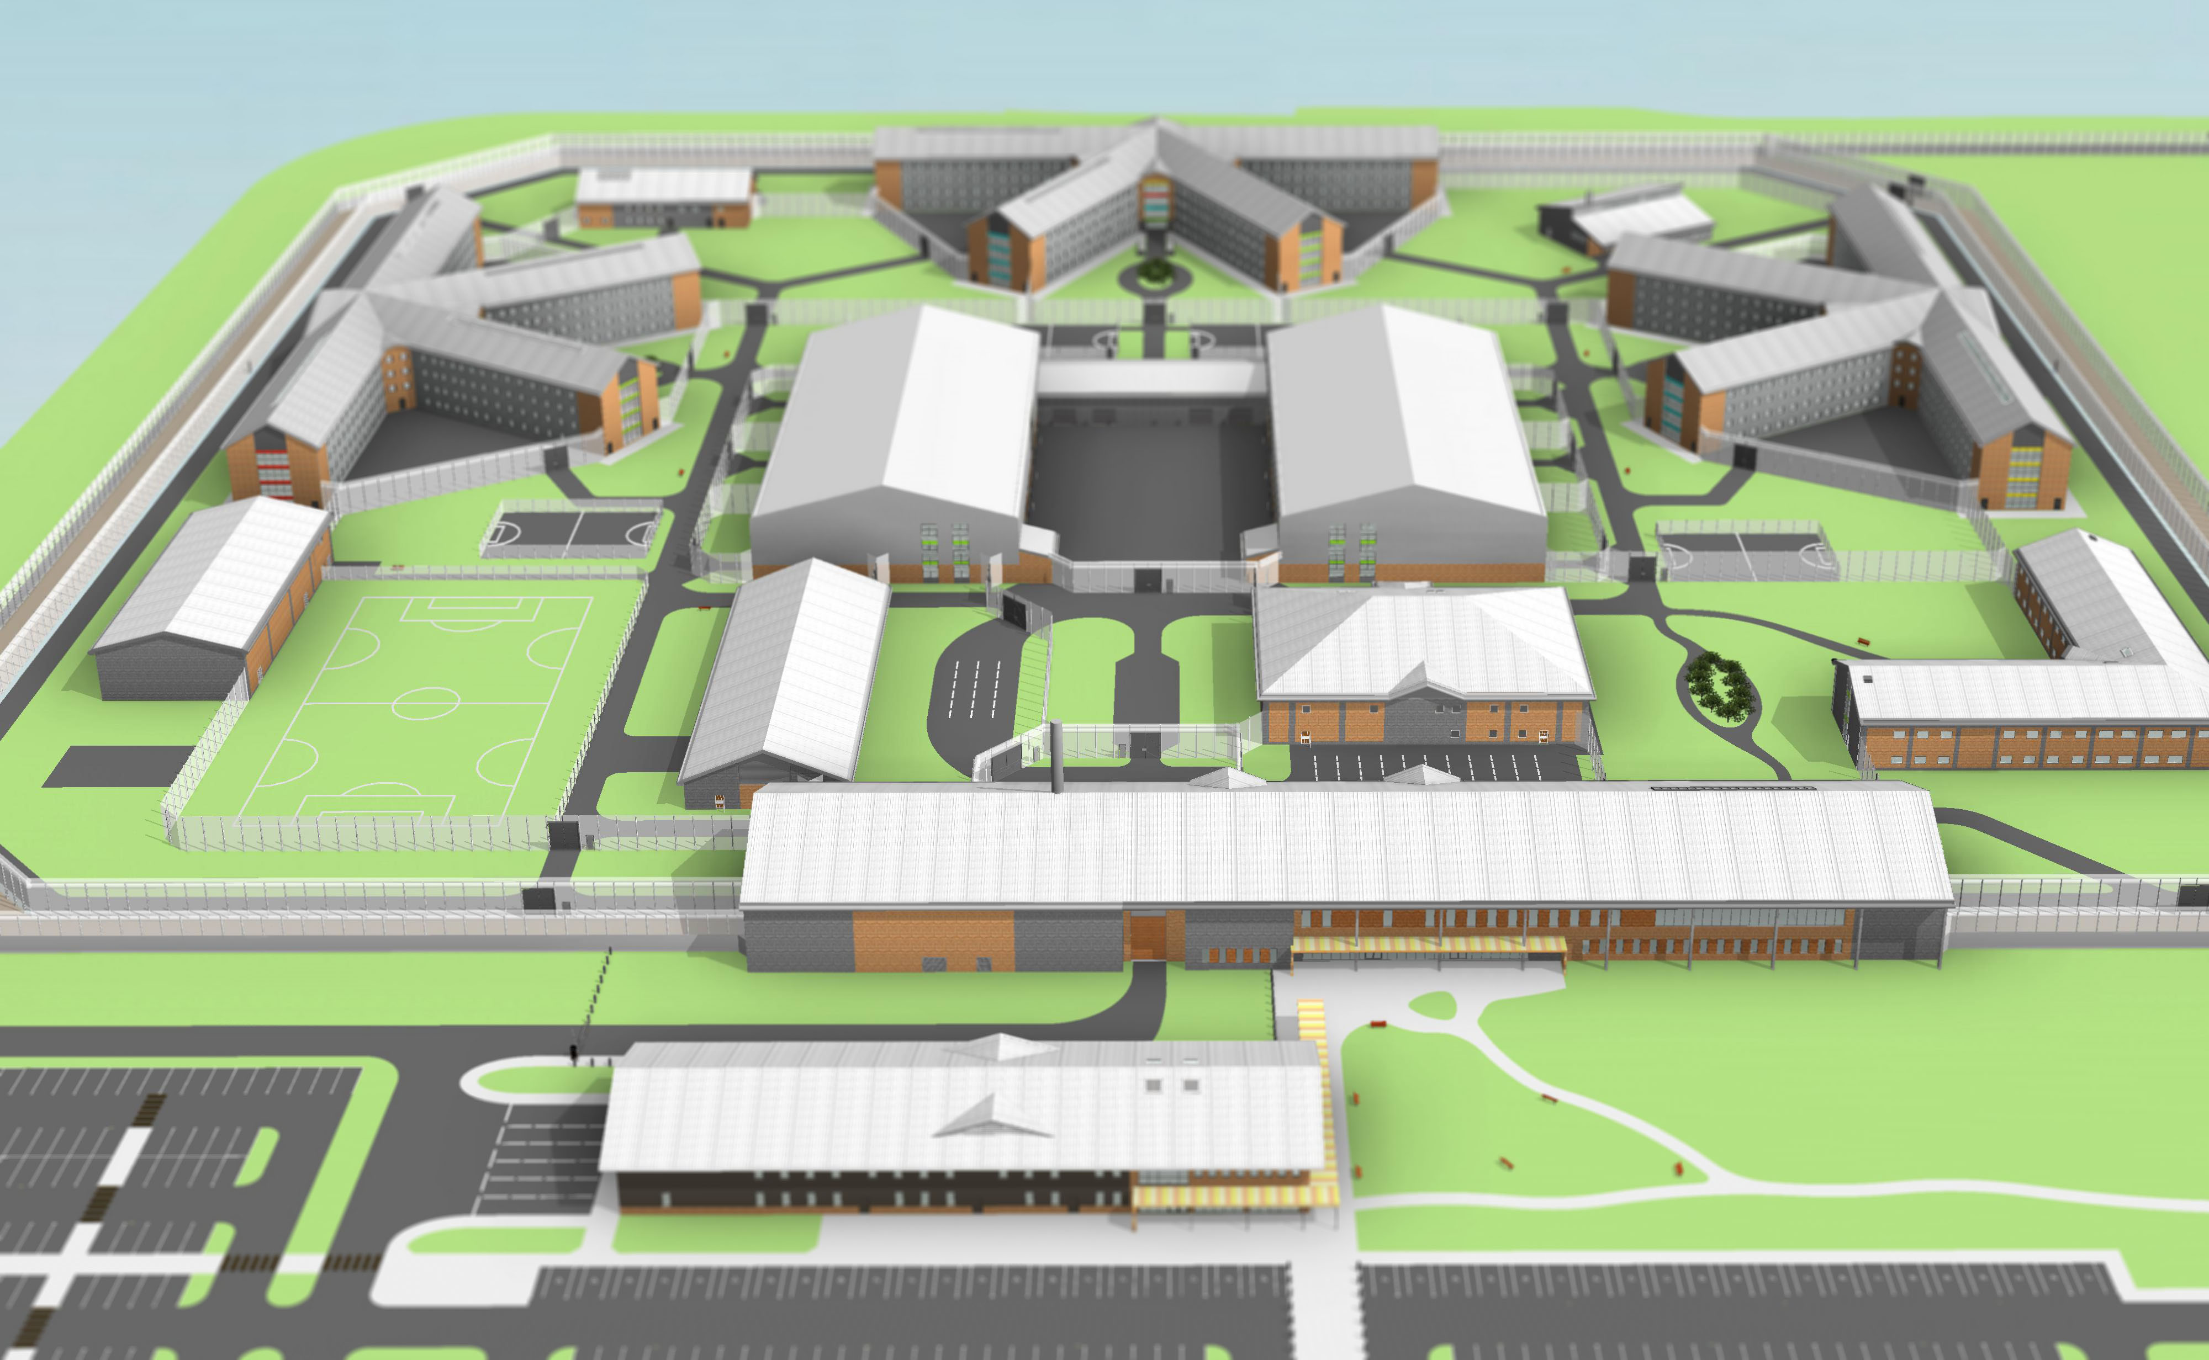
North Wales Prison – Indicative 3D view of Design Model – October 2014
Sheet 1 of 6

Slide 2
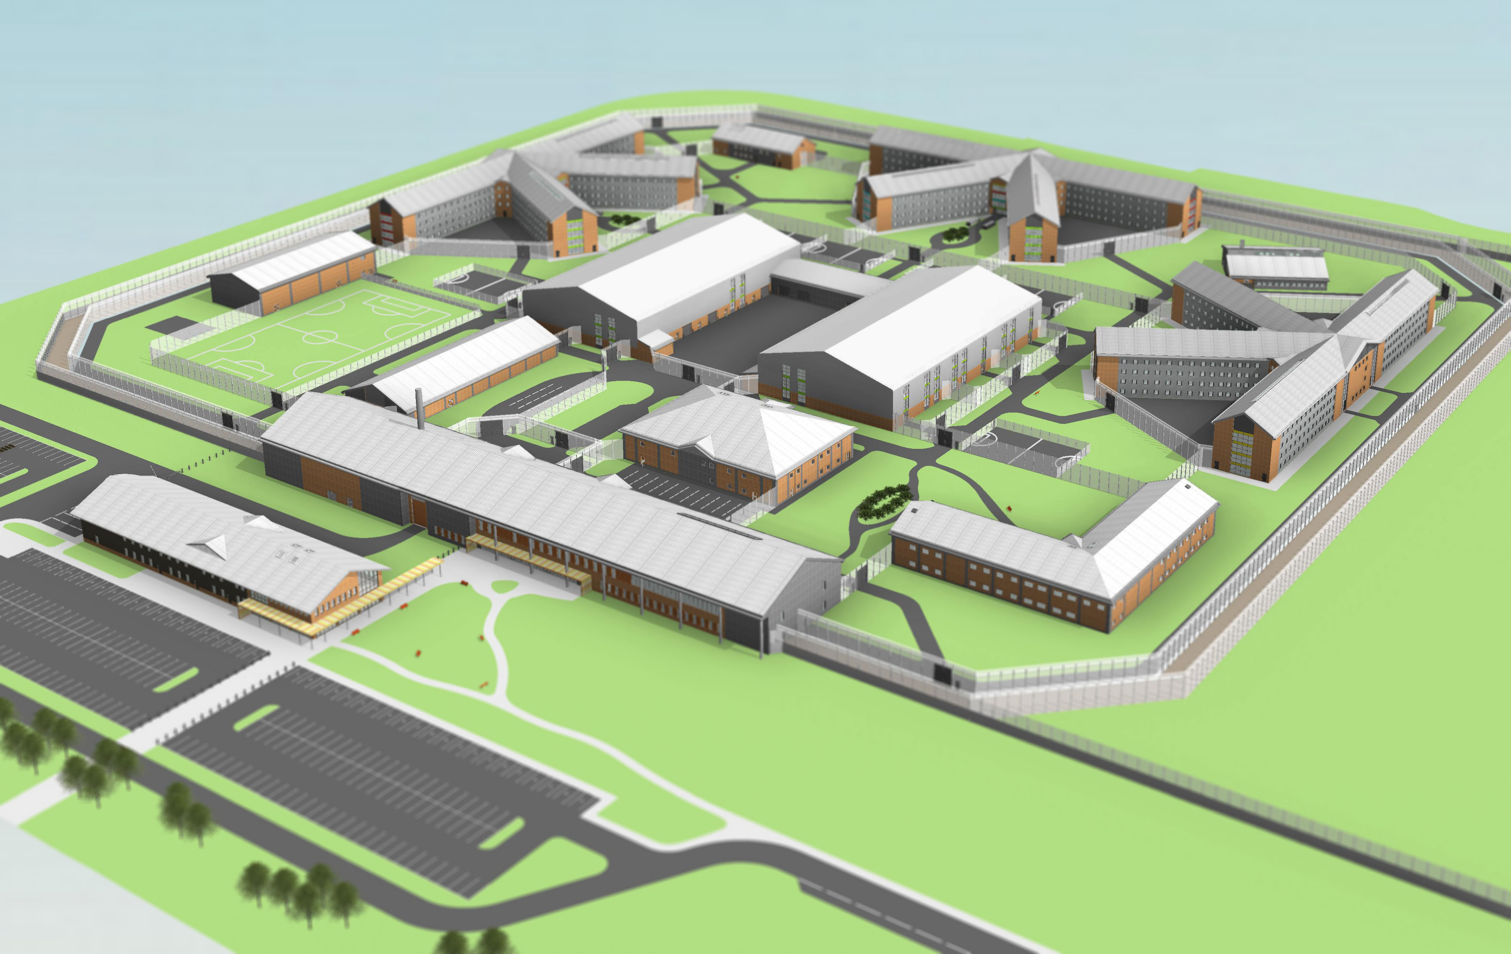
North Wales Prison – Indicative 3D view of Design Model – October 2014
Sheet 2 of 6

Slide 3
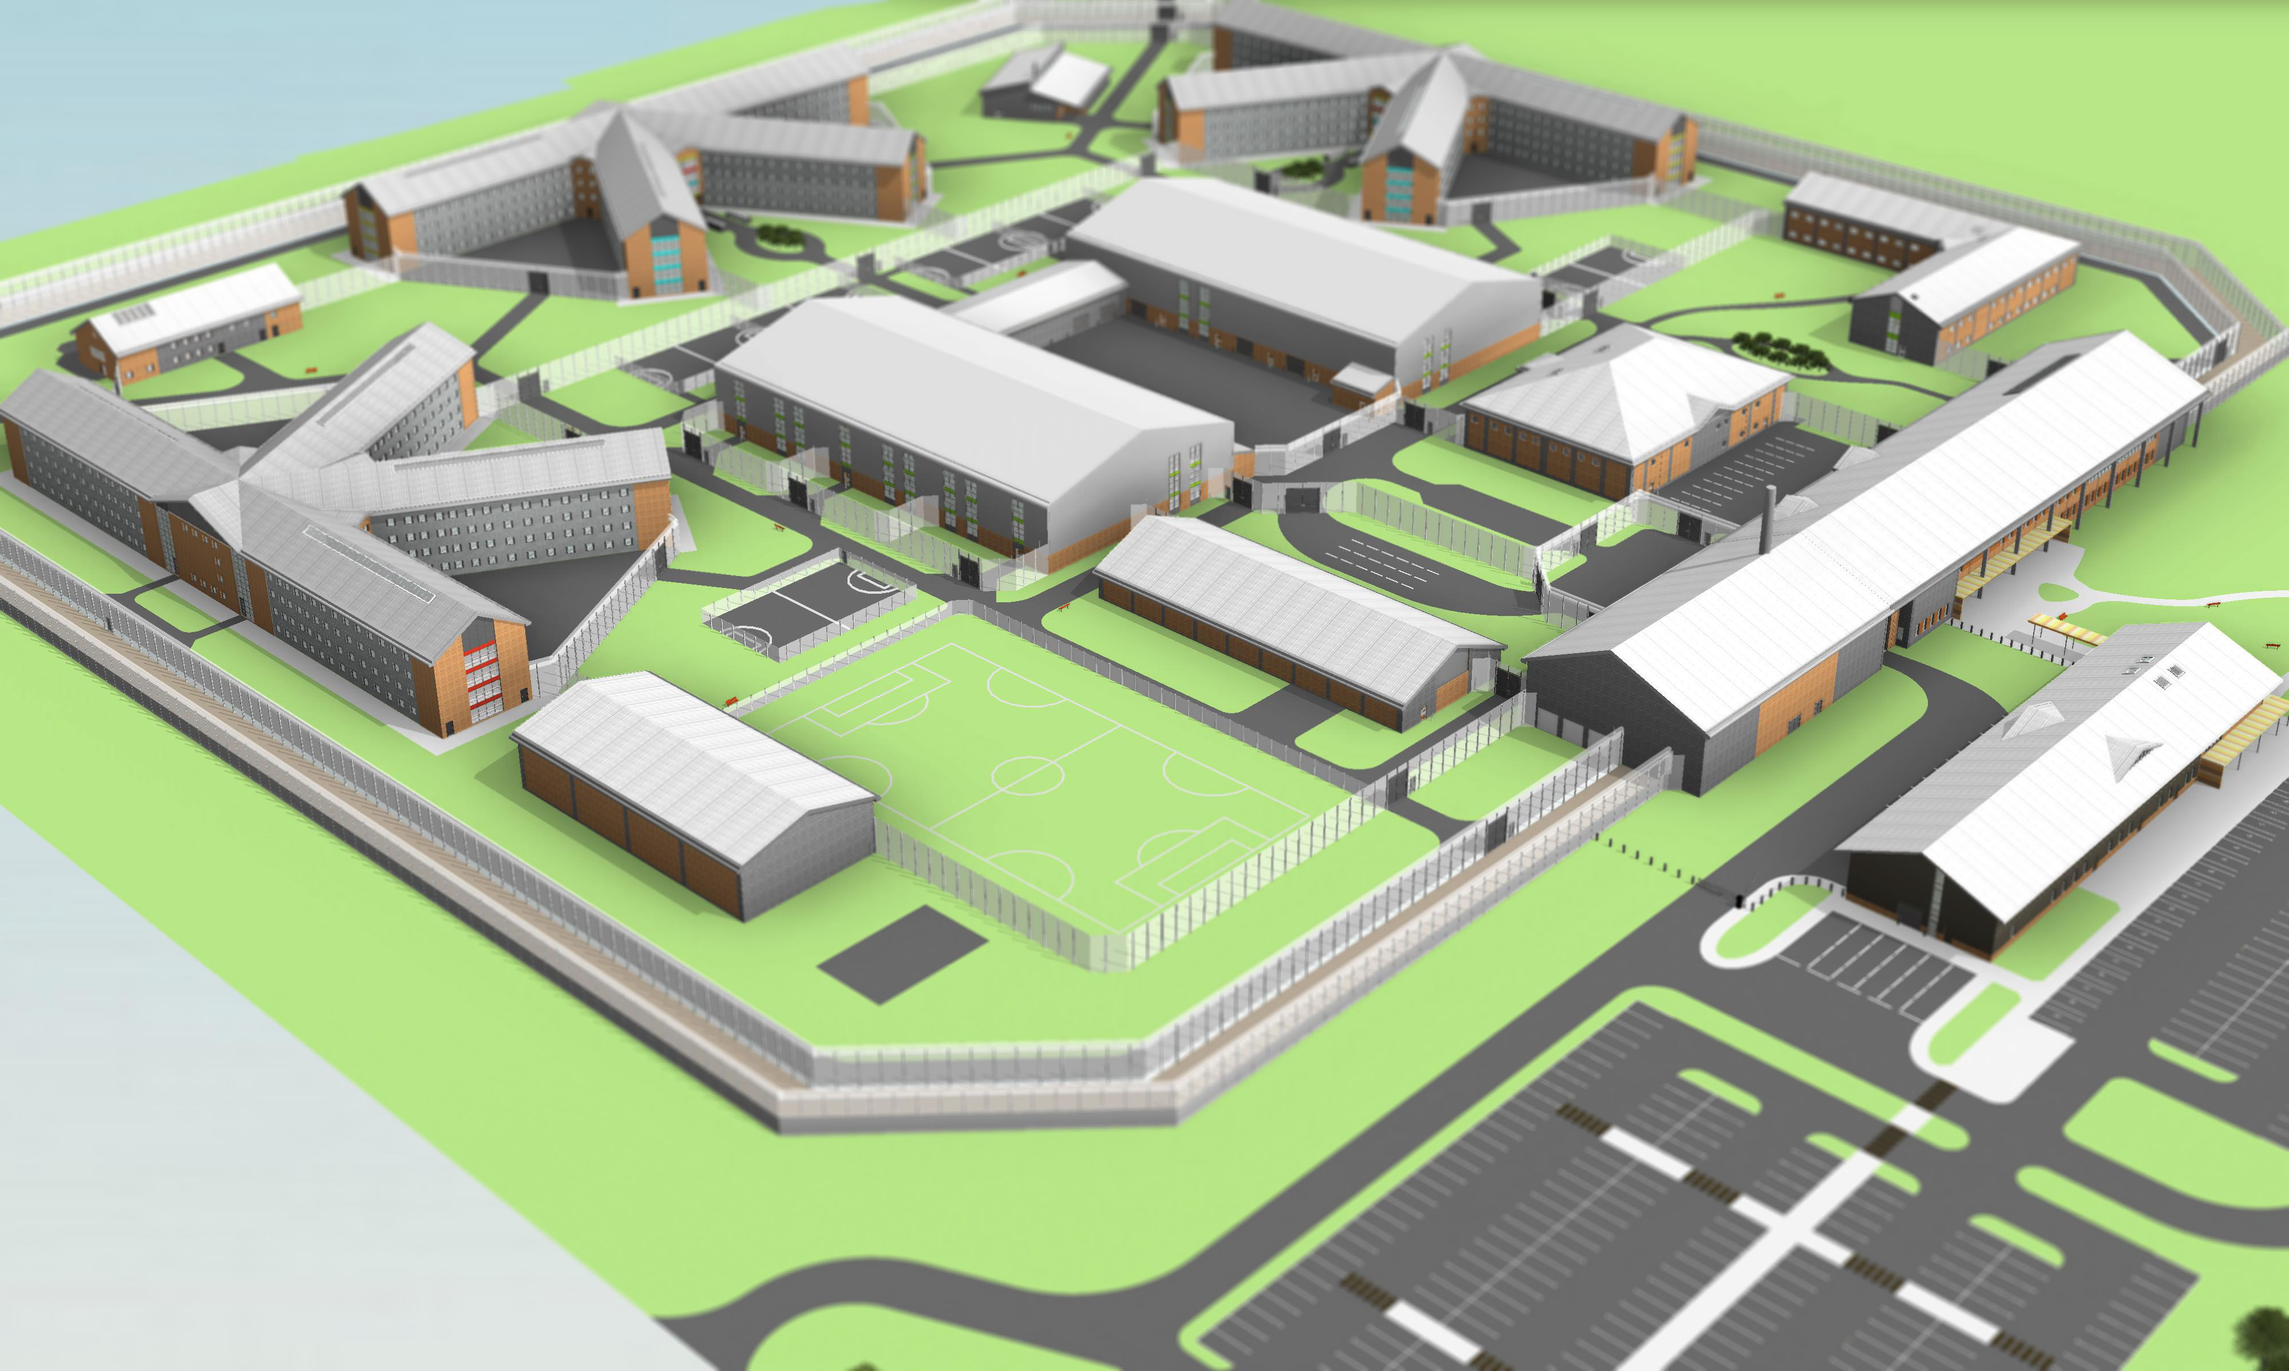
North Wales Prison – Indicative 3D view of Design Model – October 2014
Sheet 3 of 6

Slide 4
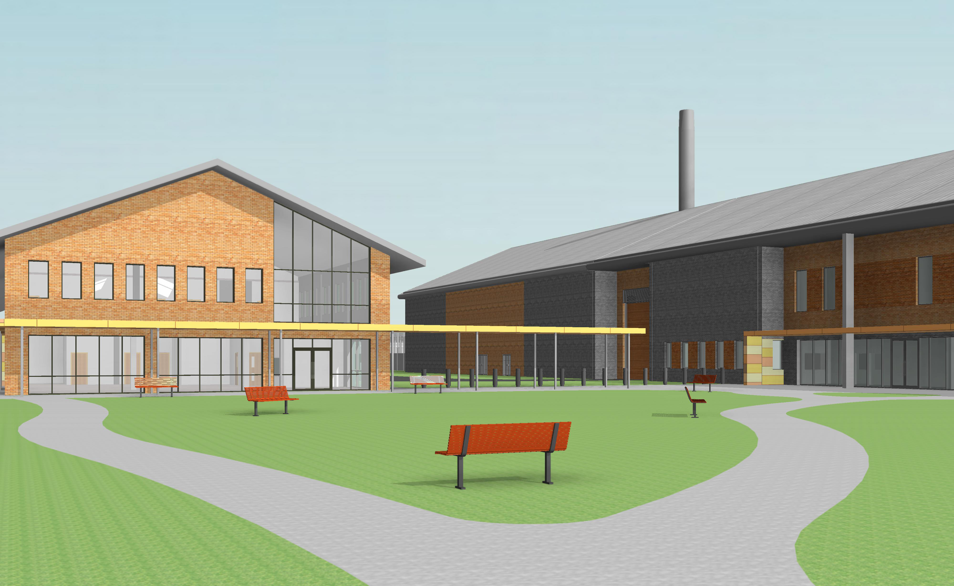
North Wales Prison – Indicative 3D view of Design Model – October 2014
Sheet 4 of 6

Slide 5
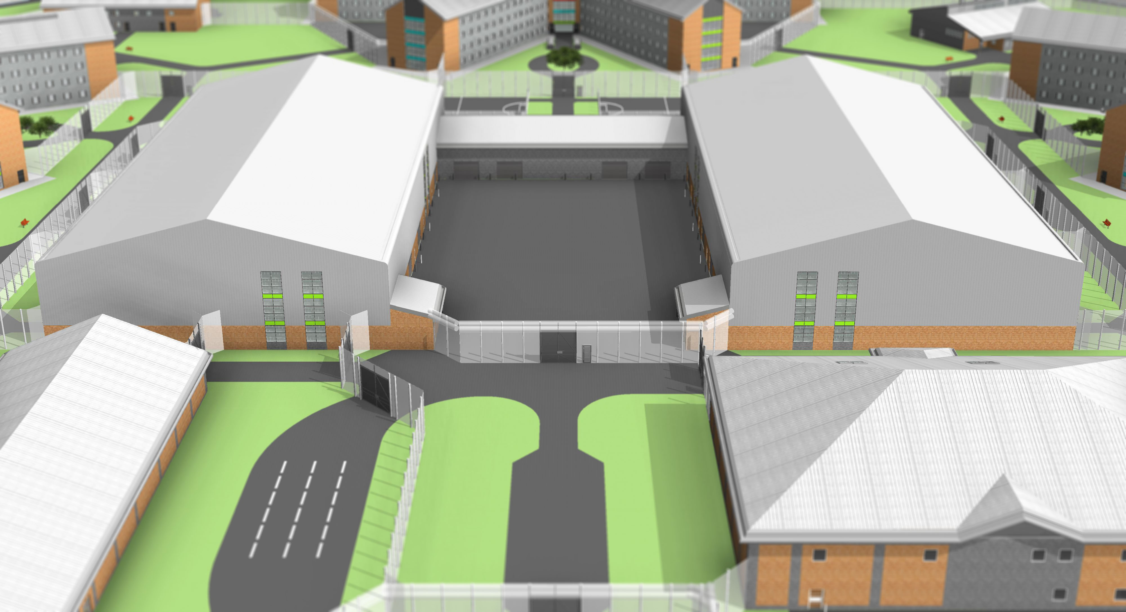
North Wales Prison – Indicative 3D view of Design Model – October 2014
Sheet 5 of 6

Slide 6
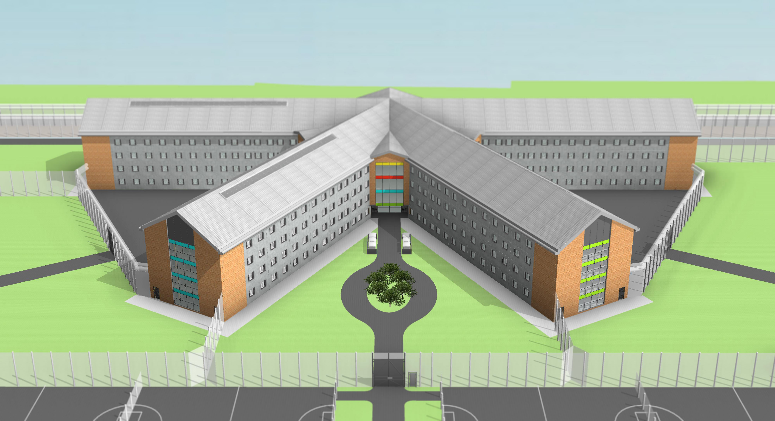
North Wales Prison – Indicative 3D view of Design Model – October 2014
Sheet 6 of 6

