Slide 1
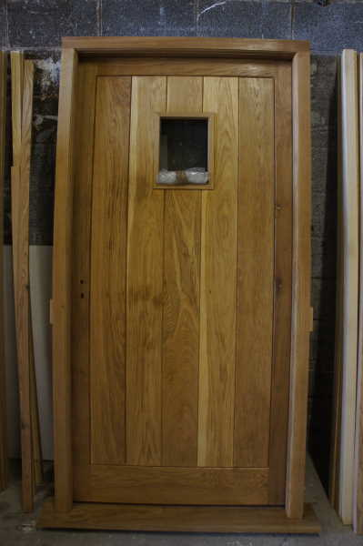
New Door – 5 Gun street, Rossett, Wrexham.
Manufaactured prime grade using European Oak.
Curved head packer as per current design.
Double boarded.
Clear Varnish - Osmo oil

